Slide 1
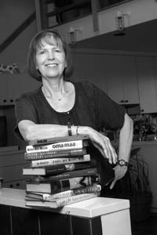

HUSB 143 Contemporary American Literature
Bobbie Ann Mason, “Shiloh” (1982)

Slide 2
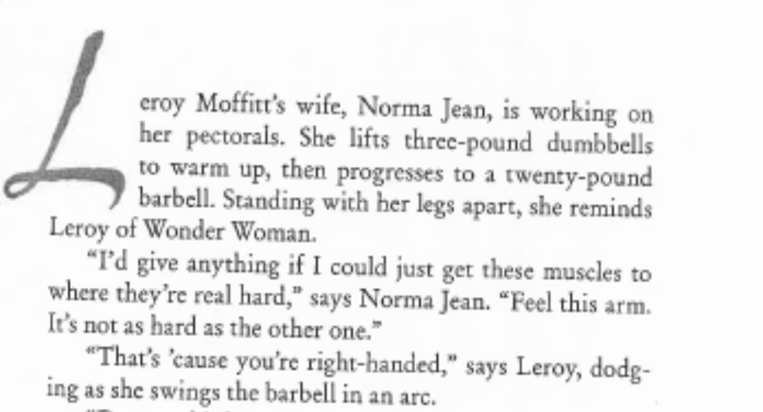

HUSB 143 Contemporary American Literature
Bobbie Ann Mason, “Shiloh” (1982)

Slide 3
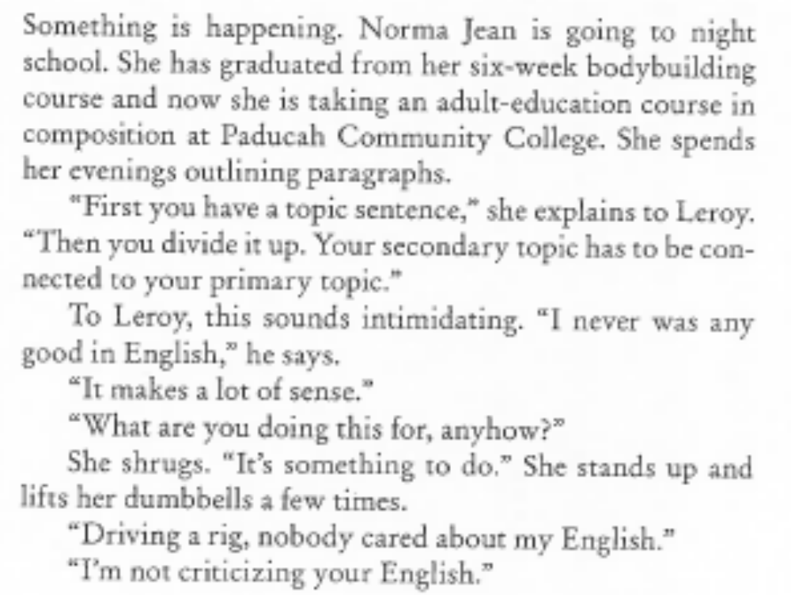

HUSB 143 Contemporary American Literature
Bobbie Ann Mason, “Shiloh” (1982)

